Slide 1

SUPPLY CHAIN ANALYSIS

Slide 2
TEAM MEMBERS
DURGA SYAMALA MAREEDU(TEAM LEAD)
SHAIK ASIF ALI
NITHISH KUMAR MAYAVAN
KEERTHI KAPPERA
DATA ANALYSIS
DATA PREPROCESSING
TRAINING AND TESTING
DEPLOYMENT AND APPLICATION

Slide 3
PROBLEM STATEMENT
How can historical sales data be used to improve demand forecasting accuracy and optimize inventory levels in the supply chain?
What strategies can help identify areas where costs can be reduced in the supply chain, such as through bulk purchasing or process improvements?
What data-driven models and analytics can help in capacity planning to ensure that production and distribution capabilities match demand fluctuations?

Slide 4
Employing statistical models and machine learning algorithms to analyze historical sales data and market trends, allowing for accurate demand forecasts and inventory optimization.
Using data analysis to identify cost-saving opportunities, such as negotiating bulk purchasing agreements, optimizing production processes, and reducing waste.
Utilizing capacity planning models that incorporate historical data and demand forecasts to ensure that production and distribution capabilities align with market demand.
SUGGEST
SOULTIONS

Slide 5
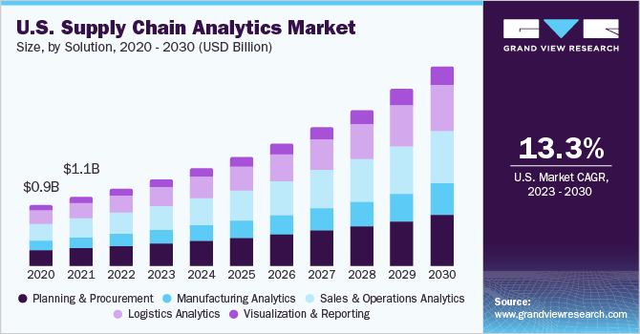
MARKET SIZE
The global supply chain analytics market size was estimated at USD 6.12 billion in 2022 and is anticipated to grow at a compound annual growth rate (CAGR) of 17.8% from 2023 to 2030. The supply chain analytics (SCA) market is growing in demand due to increased awareness of the benefits of SCA solutions, such as forecasting accuracy, supply chain optimization, waste minimization, and meaningful synthesis of business data. The increasing number of small & medium enterprises and their increasing expenditure on implementing analytics to hold a strong position in the market and compete against other market players are expected to boost the market growth over the forecast period.

Slide 6
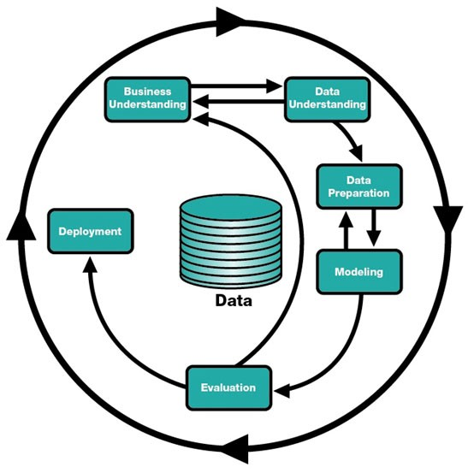
BUSINESS
MODEL

Slide 7
Business understanding for supply chain analysis involves gaining a comprehensive understanding of how a company's supply chain functions and the various factors that impact it.
BUSINESS
UNDERSTANDING
For instance, XYZ Electronics aims to increase its market share by 15% over the next two years while maintaining or improving profit margins.

Slide 8

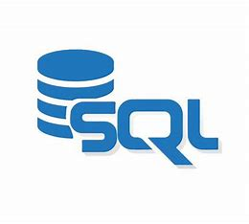

TECHNOLOGY / EXPERTISE
Python is a versatile programming language for data analysis. Libraries such as NumPy, Pandas, and SciPy are widely used for data manipulation and analysis.
TECHNOLOGIES
WE ARE
GOING TO
USE
Structured Query Language (SQL) databases like MySQL and PostgreSQL are used for data storage and retrieval in supply chain analysis.
Tools like Plotly, and Matplotlib enable the creation of interactive and informative data visualizations to aid in understanding supply chain trends and patterns.

Slide 9
ROAD MAP
Data Collection and Integration
Data Cleaning and Preparation
Exploratory Data Analysis
Implementation
Model Deployment
Model Development

Slide 10
WHY WE ARE BETTER
Accurate demand forecasting
Supplier Performance Analysis
Reduced cost with better efficiency

Slide 11


